Slide 1




MASTERING MOVIE DATA: ETL AND VISUALIZATION WITH PYTHON AND OLAP QUERIES
STADVDB S11 GROUP 2
Gayamo, Santos, Tasarra

Slide 2

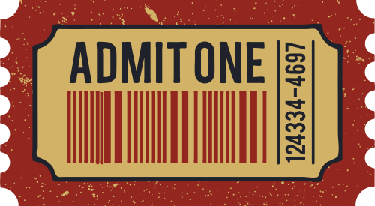
OUTLINE
This project is centered on building and optimizing a data warehouse using a movie dataset.
This project used OLAP application to perform queries

Slide 3

DATA WAREHOUSE
The data warehouse is a storage system that stores data from multiple databases
The information is used for data analytics

Slide 4

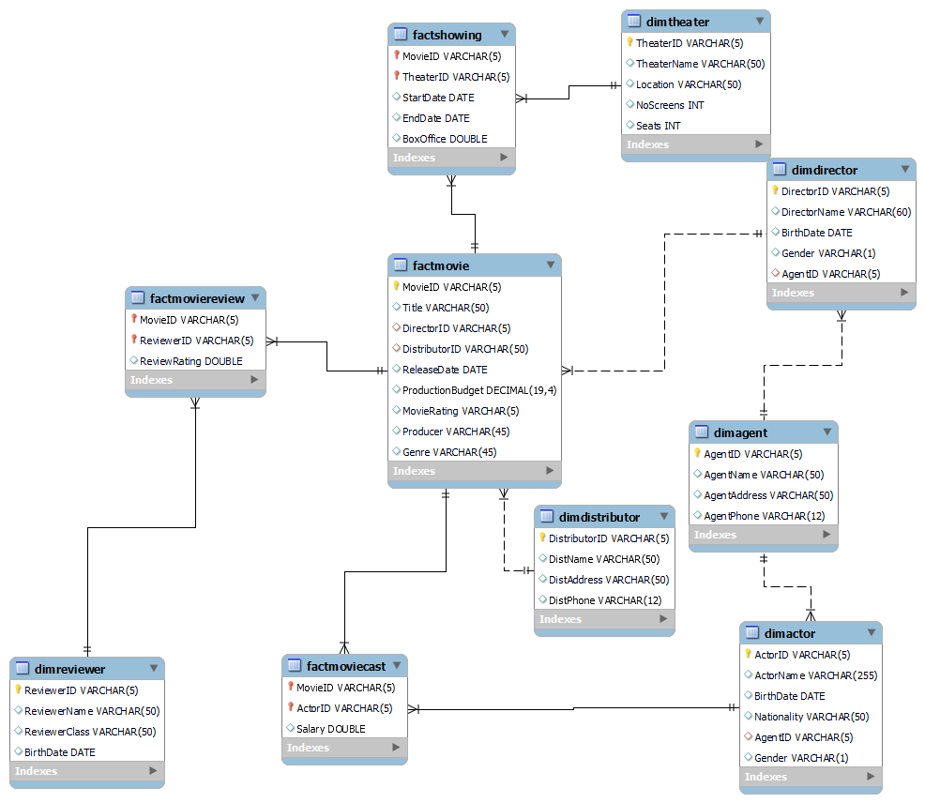

Slide 5

CREATING THE DATA WAREHOUSE
The Movies dataset was redesigned to enhance the speed of database access
This was achieved by denormalizing the data using a star schema

Slide 6




DENORMALIZATION
The act of inserting extra data into database tables to enhance the speed of database access

Slide 7

ETL SCRIPT
The a process that populates a data warehouse with data

Slide 8



ETL PROCESS OVERVIEW

Slide 9

OLAP APPLICATION
OLAP or Online Analytical Processing, is a technique for analyzing data that is performed on multidimensional data.

Slide 10

QUERY PROCESSING
AND OPTIMIZATION

Slide 11
QUERY PROCESSING
AND OPTIMIZATION
Use of Indexes
Use of Denormalized Table
Use of Temporary Table

Slide 12


RESULTS & ANALYSIS

Slide 13
RESULTS & ANALYSIS
Functional Testing
Testing ETL Script Using Row Count Comparison
Testing Application Using Result Comparison
Performance Testing
Testing Using Query Cost
Testing Using Time Comparison

Slide 14

CONCLUSION
DIFFERENT TOOLS TO ACCOMPLISH THIS PROJECT:
MySQL Workbench - Used to store data and retrieve specific records through queries
Python - Used to extract data from an online database, transform it for the intended use case, and load it into a data warehouse

Slide 15

CONCLUSION
INSIGHTS GAINED FROM DOING THIS PROJECT:
Raw data can be cleaned/transformed
Understanding Data Warehousing Fundamentals
Designing Effective OLAP Applications

Slide 16



THANK YOU FOR LISTENING

